Slide 1

BlackJack Project
Rana
Yanis
Sandrine
Paris,
5 décembre 2021

Slide 2
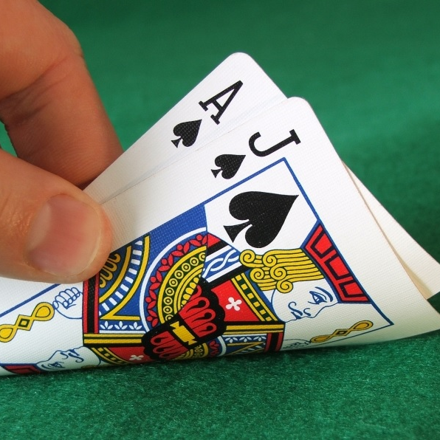
Project Description
Build your own game: the BlackJack, a popular card game.
We will create a game that interacts with the user.
We will using the functions and basic python ressources and functions.

Slide 3
RULES
The rules of the blackJack, also well known as Twenty-One, is at the same time simple and thrilling. It uses a standard 52-card pack.
OBJECT OF THE GAME
The player/user attempts to beat the dealer/computer by getting a count as close to 21 as possible, without going over 21.
CARD VALUES
Face cards are 10 and any other card is its pip value. Except, if the player's first two cards are an ace and a "ten-card" (a picture card or 10). In this case, ace worths 11 and the player’s count is 21: it is the “blackjack”.
THE PLAY
The player receives two cards and the dealer receives one card.
The player must decide whether to "stand" (not ask for another card) or "hit" (ask for another card in an attempt to get closer to a count of 21, or even hit 21 exactly). If the player goes over 21, he loses
If player decide to stand, the dealer takes or not cards – the dealer’s decisions are random.

Slide 4
Workflow
Start
User/Player is playing
stop
Computer/Dealer is playing
Compare result
Declare winner

Slide 5

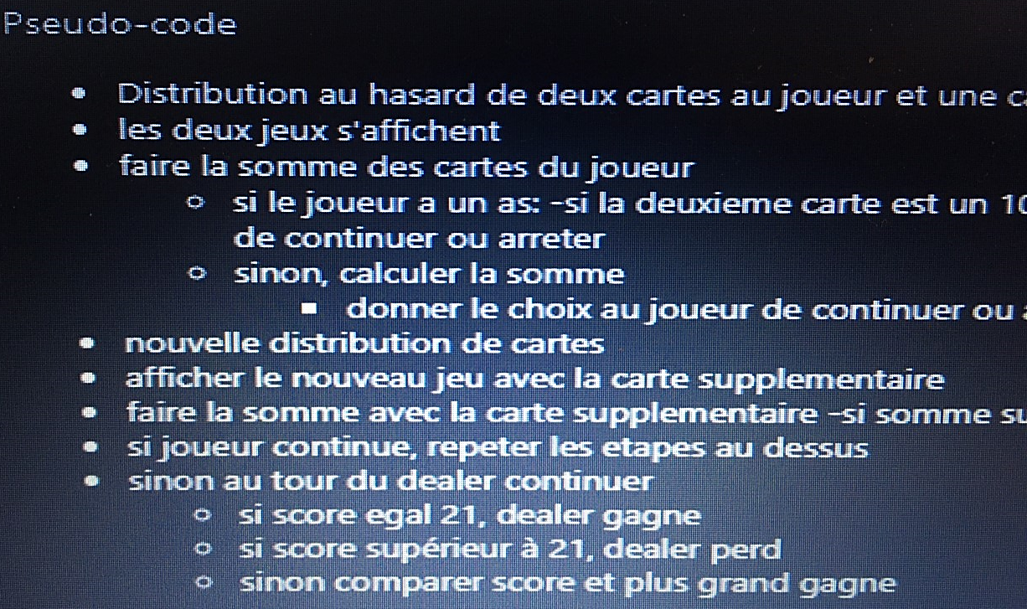
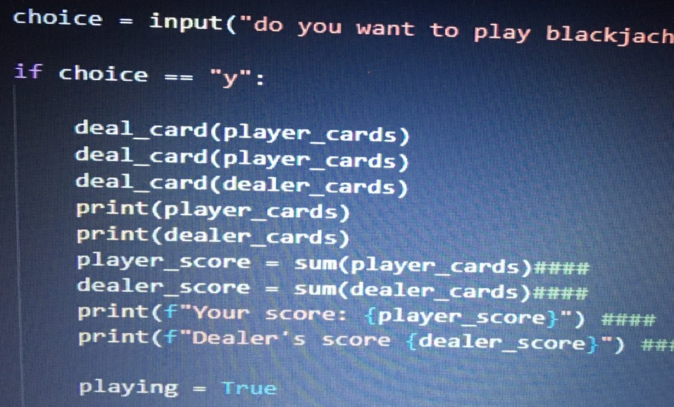
Organization
Start organization ➔ Yanis
Get used to rules ➔ Rana
Programming :
PseudoCode ➔ Sandrine
Coding ➔ all together – head of coding: Yanis
Debugging ➔ Rana, Yanis, Sandrine
Review code ➔ Yanis
Project presentation :
First Draft ➔ Sandrine
Second Draft➔ Rana
Third Draft➔ Yanis

Slide 6
Link to reposite

